Slide 1
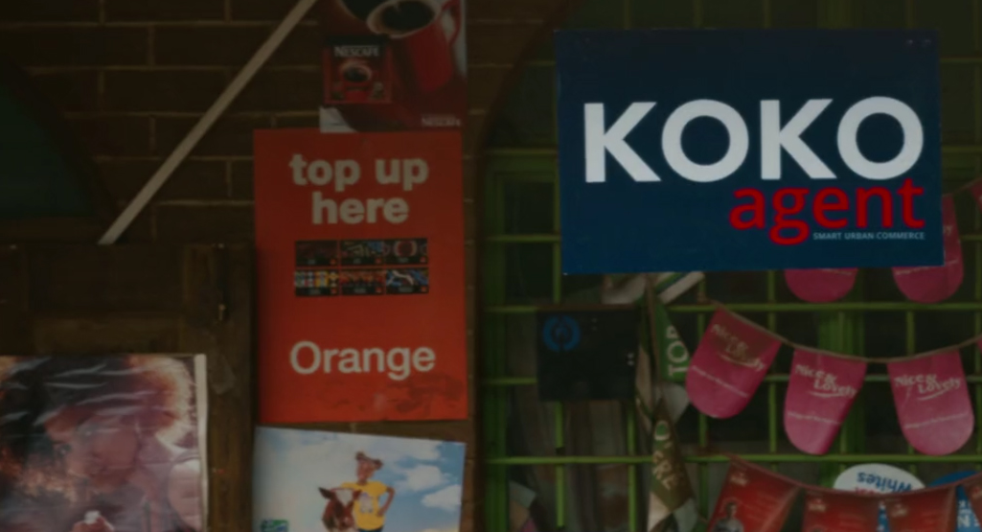

THE AGENT PIPELINE
November 2017

Slide 2
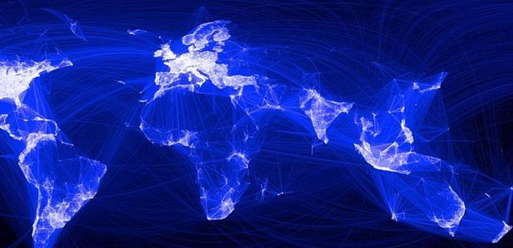
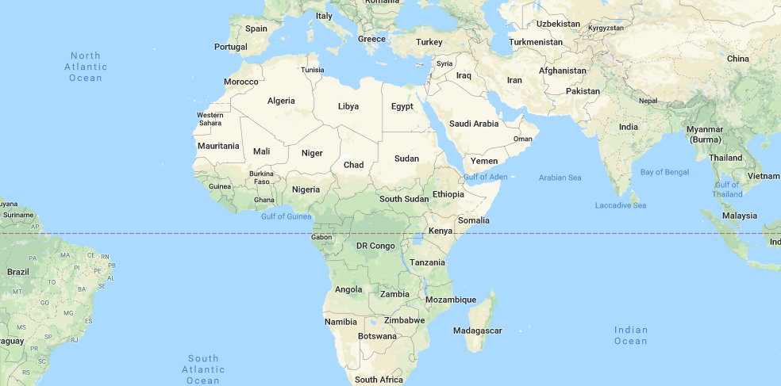

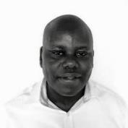
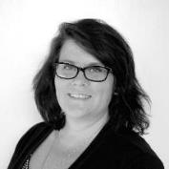
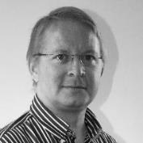
An international technology company focused on solutions that improve life in urban Africa
Network HQs in Nairobi
Office + manufacturing facilities
in Kenya + India
1st KOKO Network in Nairobi
– then expansion across Kenya
JAVAN MUNYIRI Head of Agent Network
AMANDA DONAHUE General Manager (Kenya)
GREG MURRAY Chief Executive Officer

Slide 3

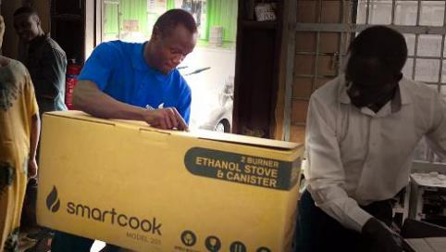


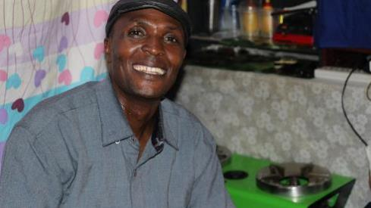
Our first consumer solution is “Smartcook”
Ed to add video links
HOW SMARTCOOK WORKS
AGENTS
Agents
CUSTOMERS
Our first consumer solution is “Smartcook”
Customers

Slide 4
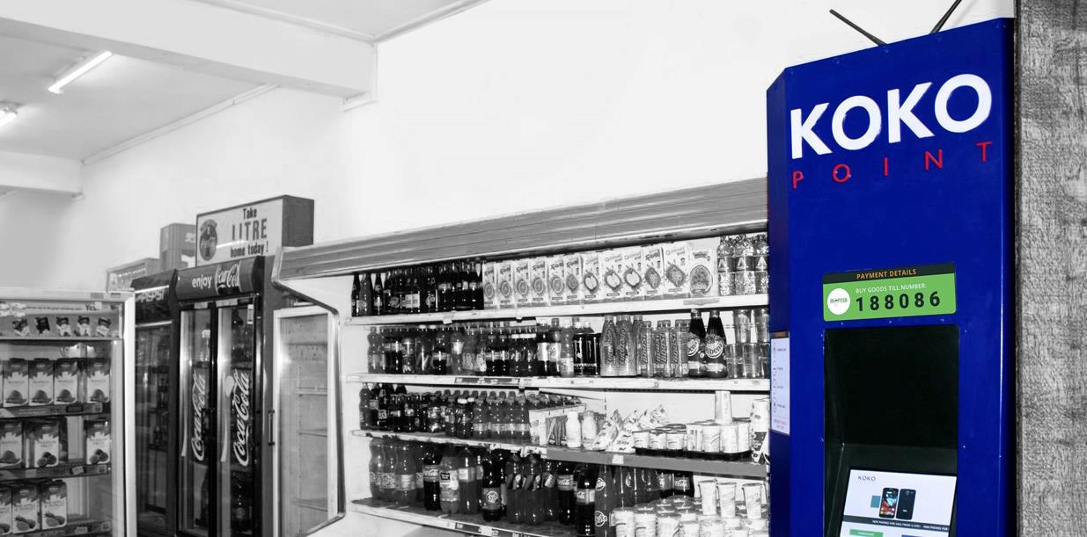
Smartcook is a new business opportunity for Nairobi retailers
COSTS
Total Upfront Agency Fees: | KES 200,000
Business Loan to Agent*: | (KES 150,000)
Net upfront investment by Agent | KES 50,000
RETURNS
Direct Sales Commission | KES 250 per customer signed up by Agent
Margin on Fuel | KES 5 per litre
*Provided by KOKO’s banking partner

Slide 5
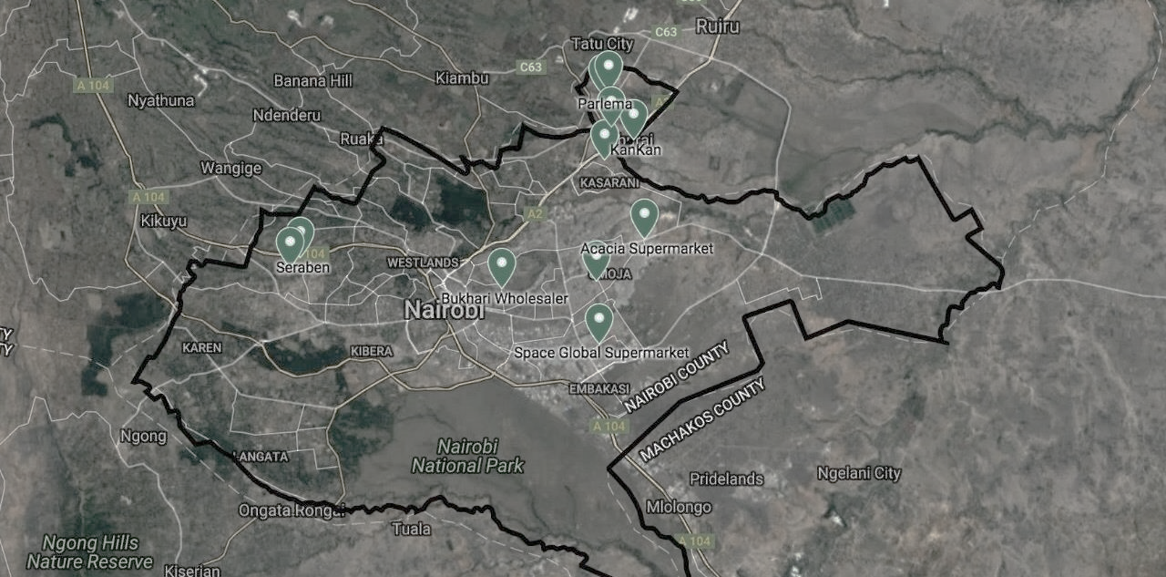
2017: Test Launch

Slide 6
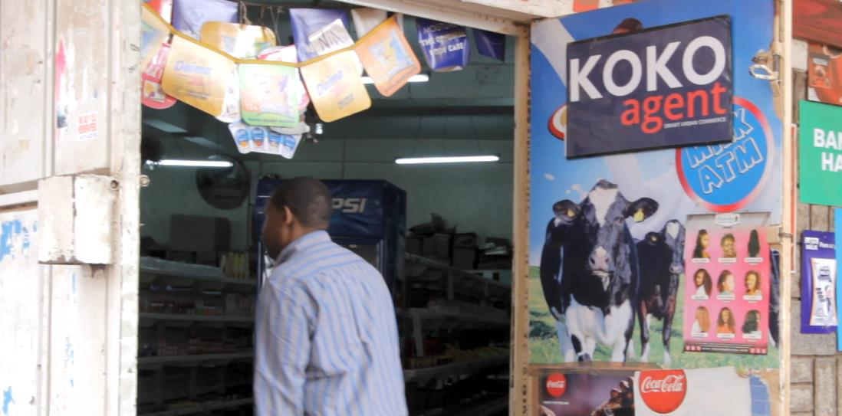
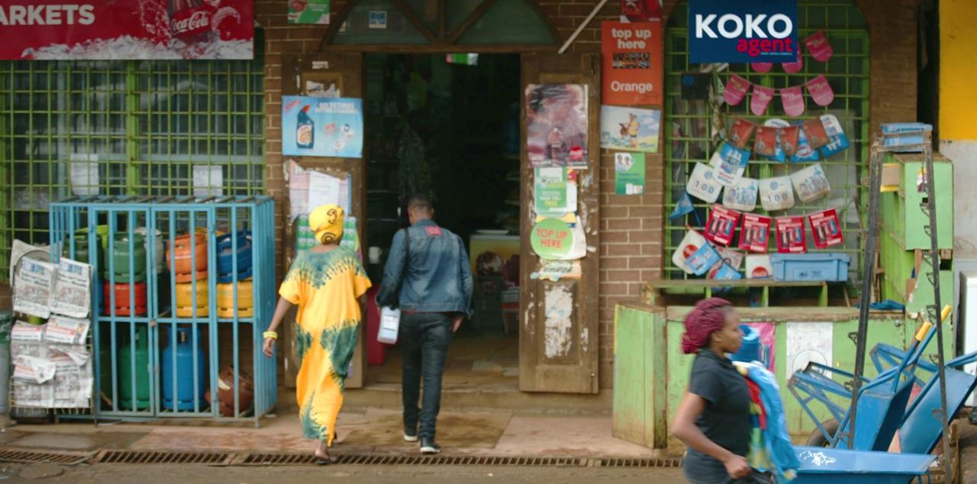
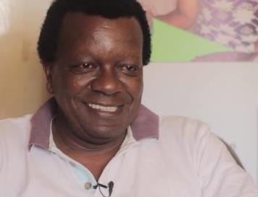
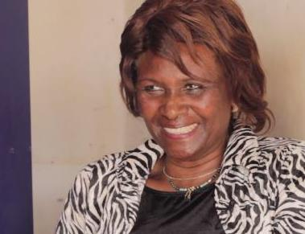

What our current Agents have to say…
Ed to add video links
NAME SURNAME
Kankan Supermarket, Kahawa West
KOKO Agent since XX
HILDA SURNAME
Mum’s Milk & Oil ATM, Kahawa West
KOKO Agent since XX

Slide 7
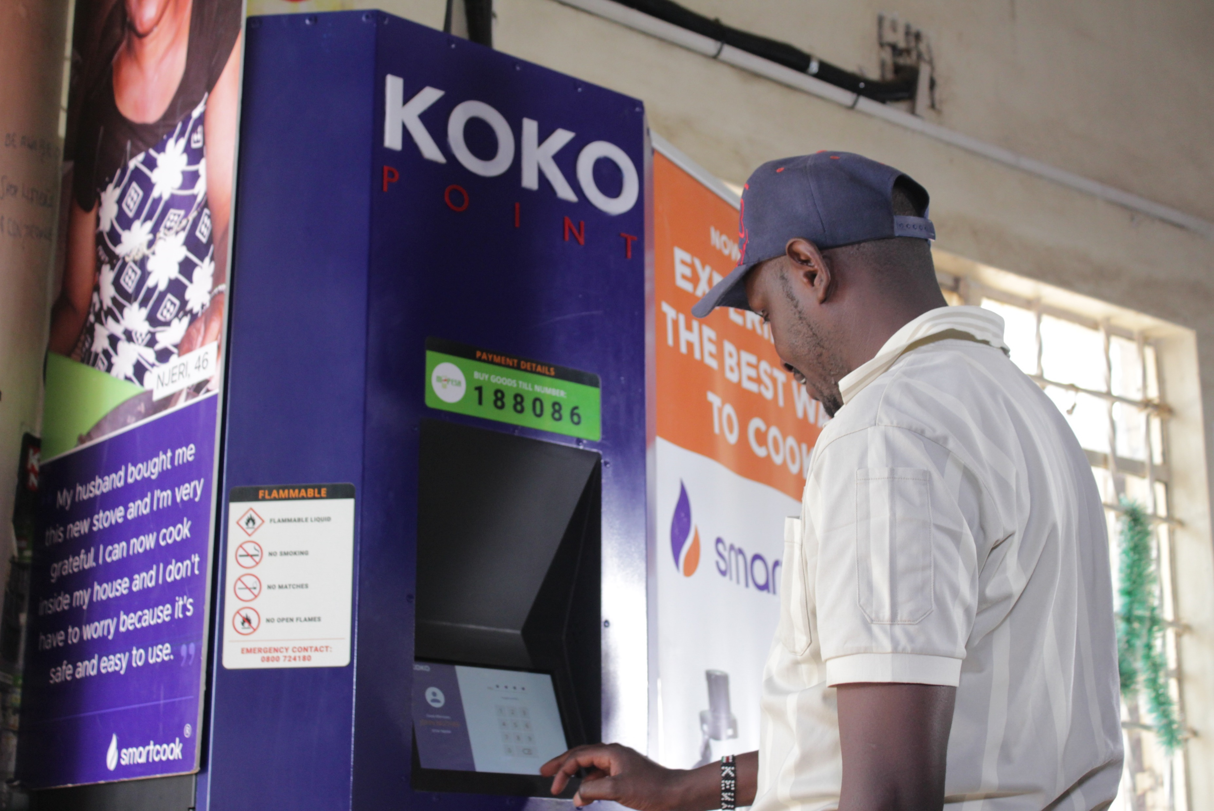
A KOKO Agent’s Journey to Full Launch
1
Sign Reservation Agreement & Pay 5k Deposit
2
Loan Application & Approval Process
3
Shop Inspections & Modification
4
Schedule KOKOpoint Installation
5
Training for Agent / Agent Staff
6
Stove Demos & Customer Pre-Orders
7
Nairobi Launch: 1,000 KOKOpoints on Day 1

Slide 8
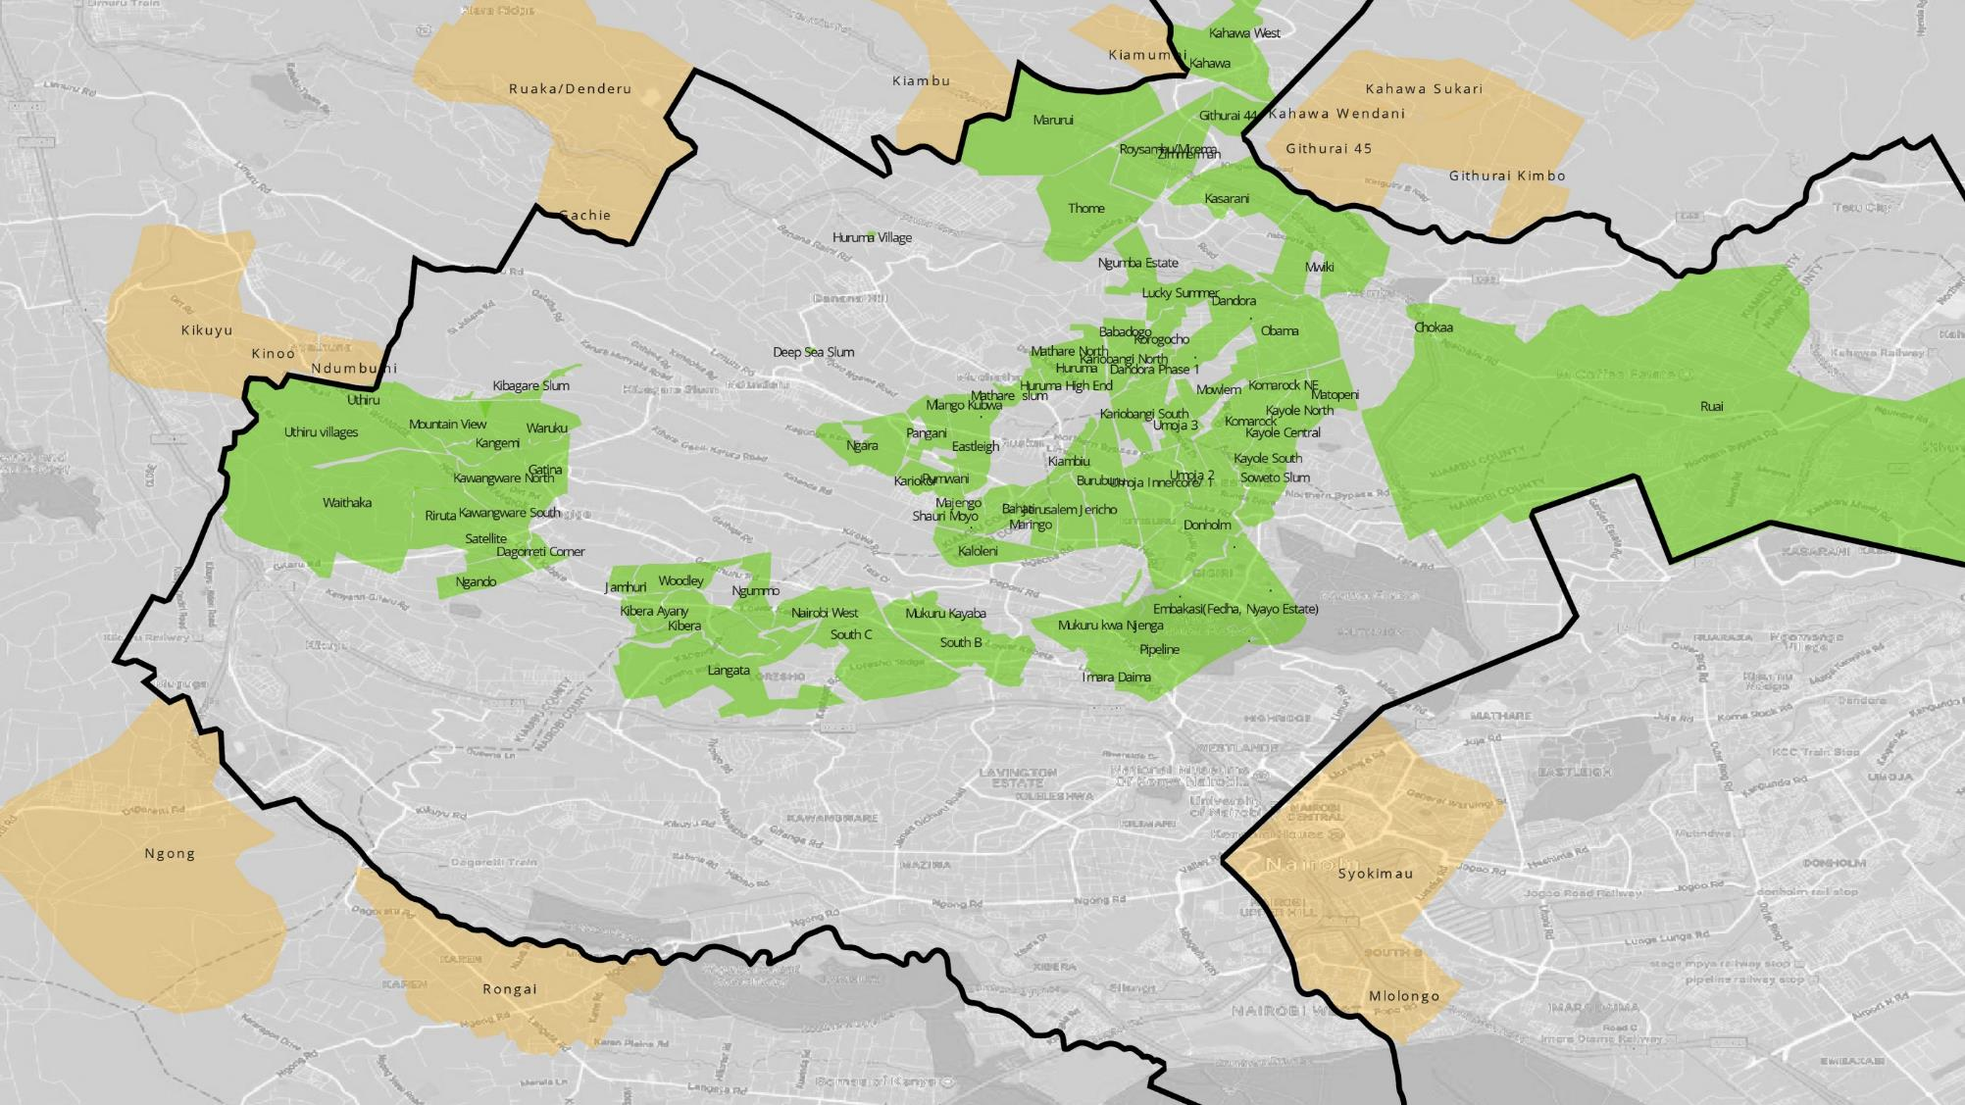
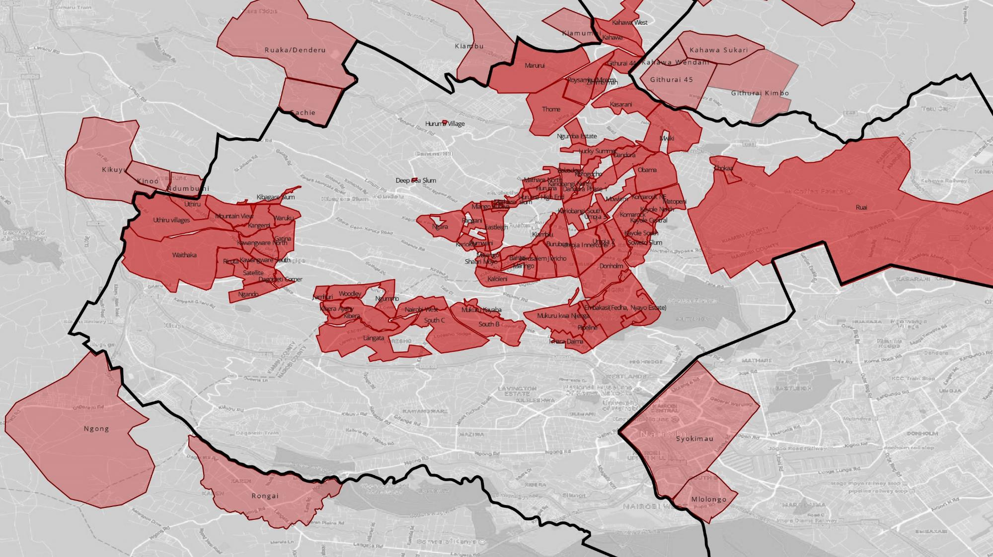
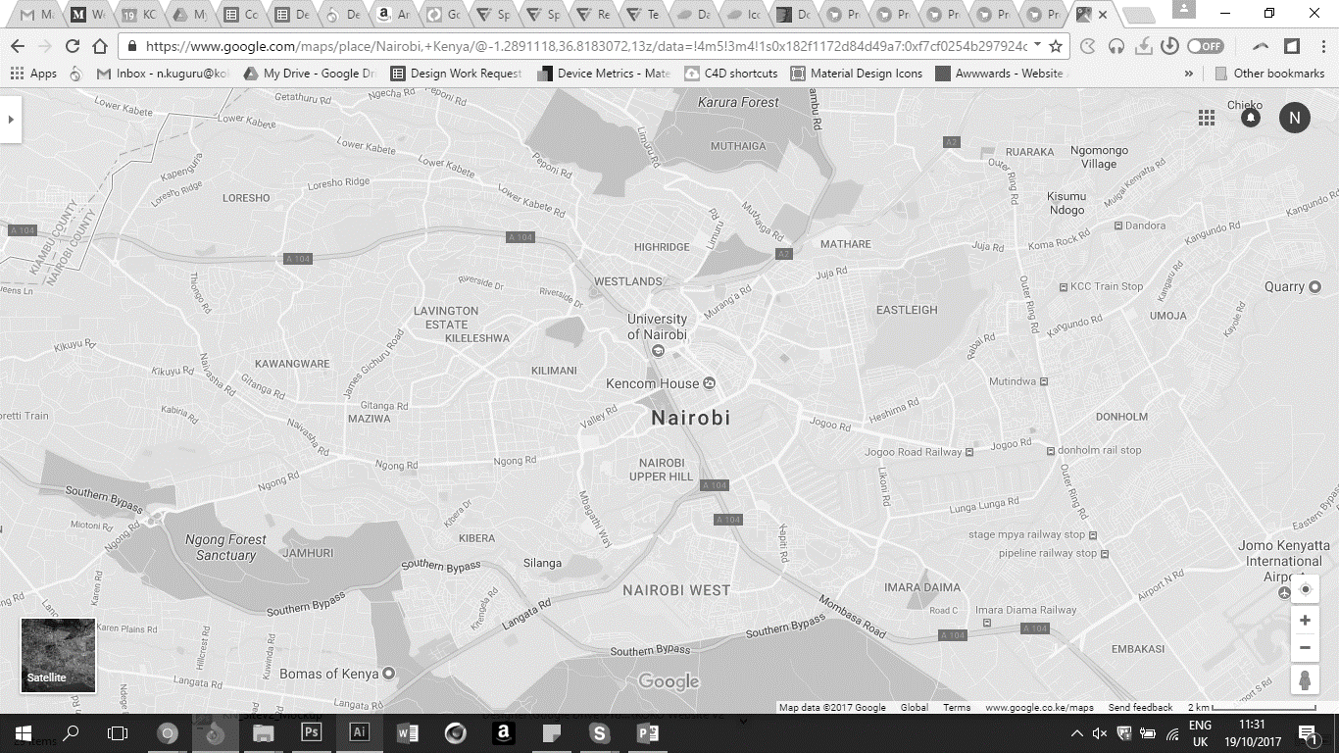
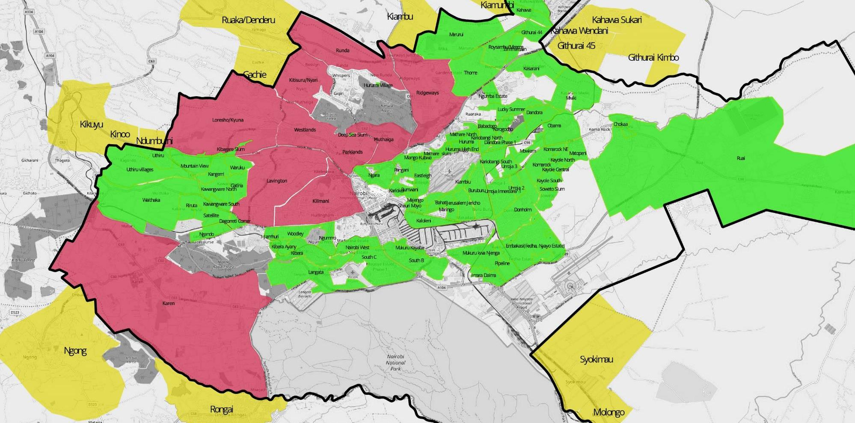

2018: KOKO will launch 1,000 Agents in Nairobi
Marketing campaign – TV, Radio & Online
KOKOpoints across Greater Nairobi, activated on “Day 1”

Slide 9
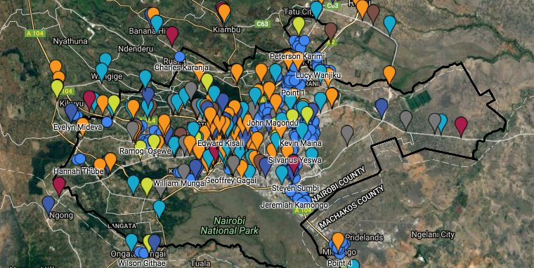
Agent Pipeline
ED IS AWAITING NEW MAP FROM AMANDA
More than 500 shopkeepers have signed reservation agreements and placed deposits

Slide 10
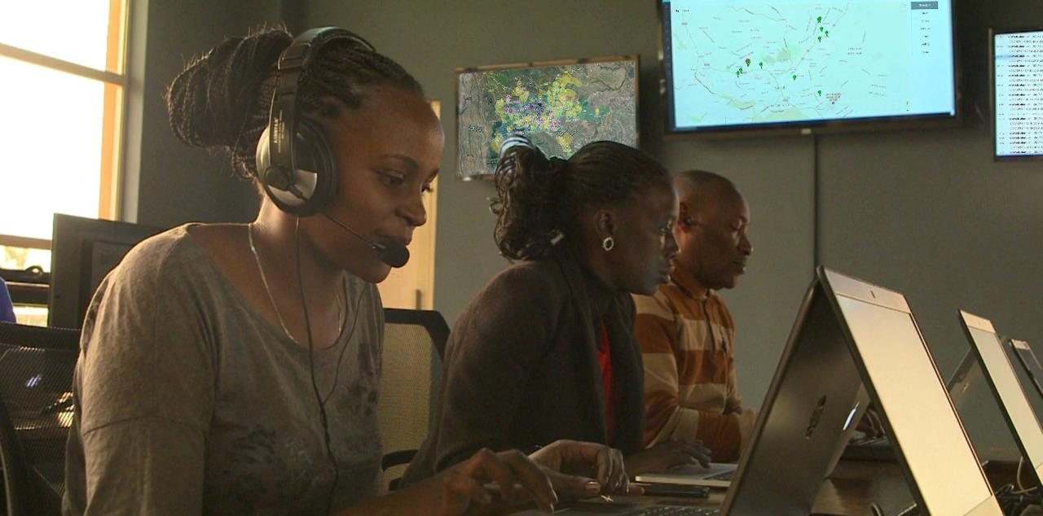
KOKO’s new Agent Experience Department provides information & support to all new & existing Agents
Means of Communication:
Follow-up Support by your TDR
Monthly Email Newsletters
Outreach by Agent Experience Team Members
Toll-free SMS & phone line

Slide 11
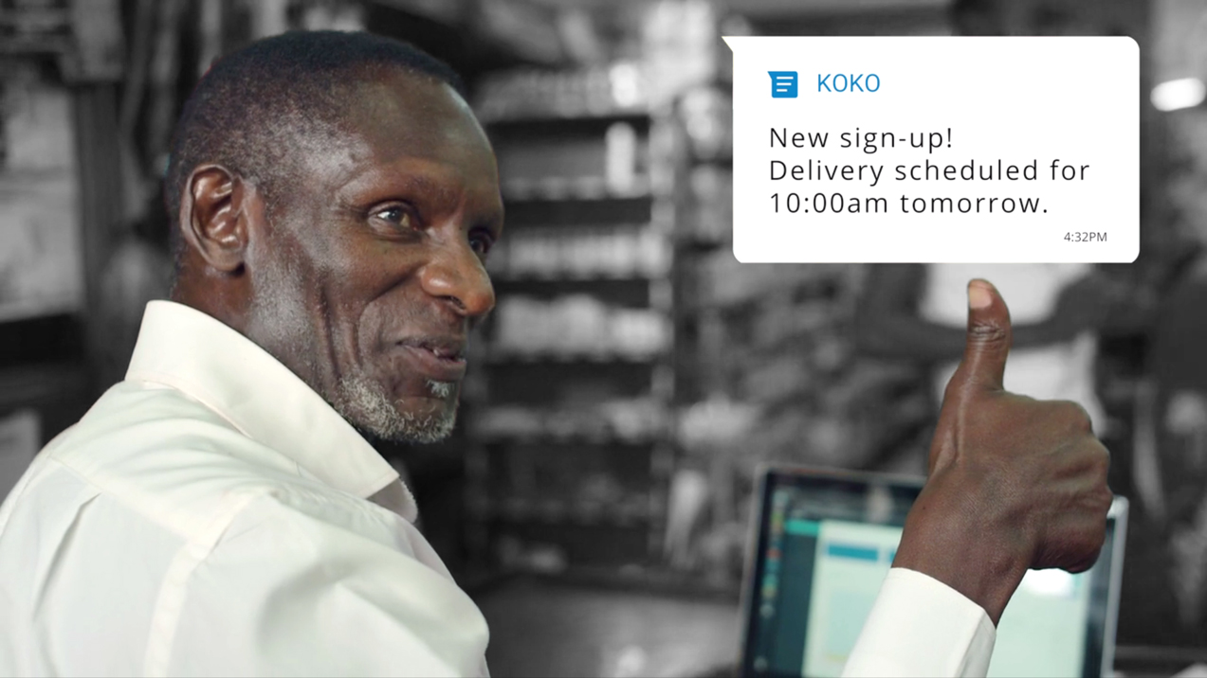
This slide needs design work – i.e. invitation for any questions from the audience
DO YOU HAVE ANY QUESTIONS ABOUT SMARTCOOK?
QUESTIONS ON SMARTCOOK?

Slide 12
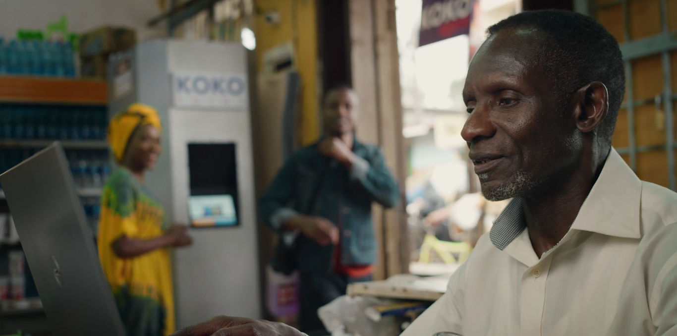



What is next, after Smartcook?
What is next, after Smartcook?
This slide needs design work – make objectives more prominent
OUR OBJECTIVE IS TO BUILD AND
DEPLOY TECHNOLOGY THAT:
Increases your revenue
Reduces your costs
Enables you to grow and expand
Our objective is to build and deploy technology that:
Increases your revenue
Reduces your costs
Enables you to grow and expand

Slide 13




R&D Focus Areas
Icons
BRINGING MORE CUSTOMERS INTO YOUR SHOPS
ENCOURAGING CUSTOMERS TO BUY MORE
EXPANDING YOUR PRODUCT SELECTION AT LOW RISK
IMPROVING MARGINS ON YOUR PRODUCTS
REDUCING YOUR LOSSES FROM THEFT
REDUCING YOUR FINANCING COSTS

Slide 14
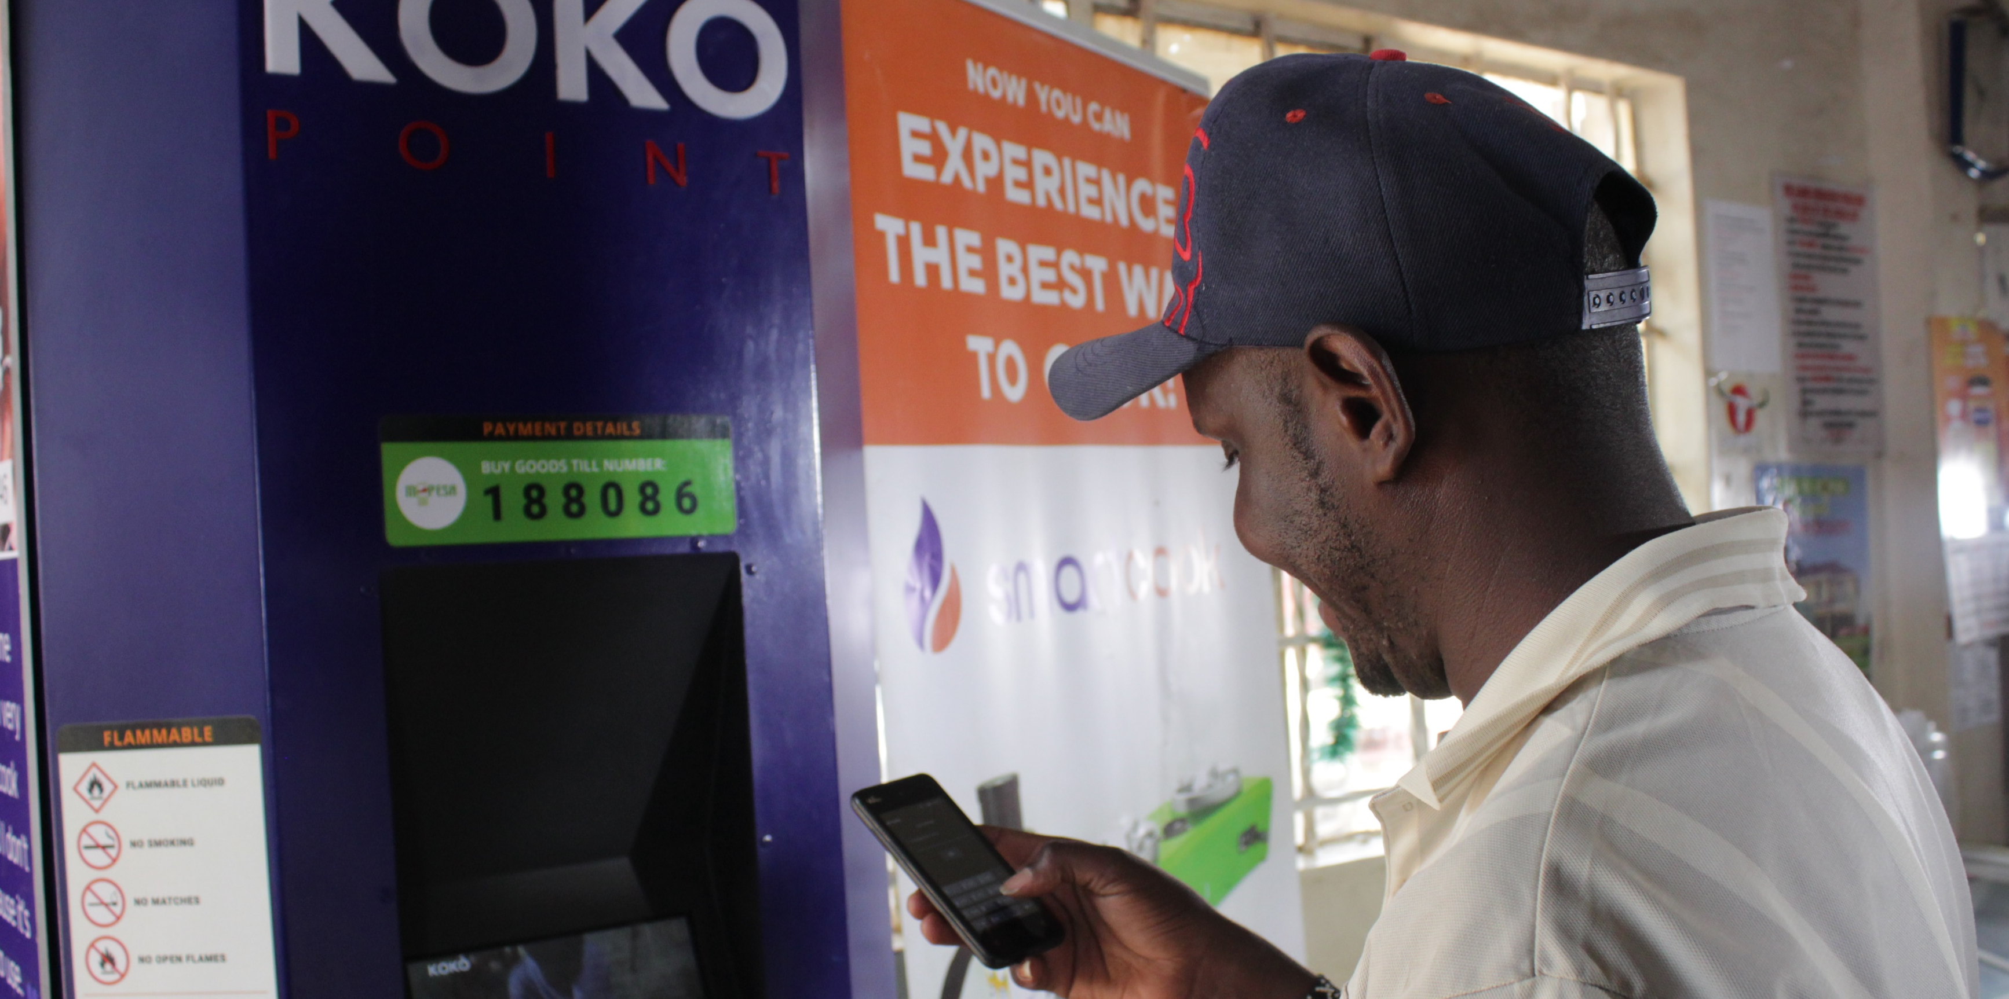
How we develop technology
This slide needs design work
1
Research
2
Develop technology & product ideas
3
Test idea with partners
4
Rapidly build and test
5
Finalize & build world-class technology
6
Pilot
7
Full Launch

Slide 15
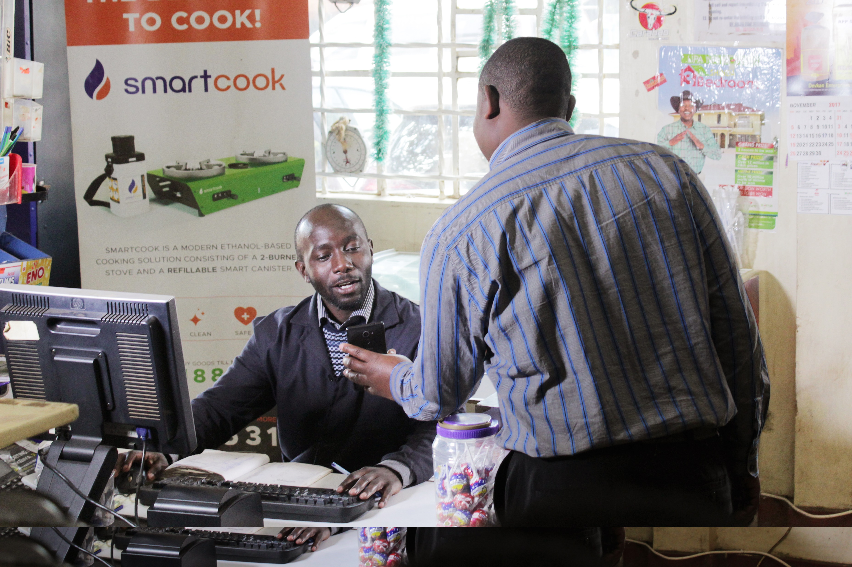


Help us help you!
This slide needs design work
We are looking for 50 shopkeepers to participate in this R&D program, who are:
Happy to share their experiences, challenges and pain points
Happy to share their retail store sales and inventory data
Willing to participate in focus groups, provide feedback on products as they develop
We are looking for 50 shopkeepers to participate in this R&D program, who:
are happy to share their experiences, challenges and pain points
are happy to share their retail store sales and inventory data
will participate in focus groups, provide feedback on products as they develop
What we offer in return for this R&D participation:
(TBD)
What we offer in return for this R&D participation:

Slide 16
This slide needs design work
QUESTIONS?
EMAIL US ANY TIME:
JAVAN MUNYIRI (Head of Agent Network) | J.Munyiri@kokonetworks.com
AMANDA DONAHUE (General Manager) | A.Donahue@kokonetworks.com
GREG MURRAY (Chief Executive Officer) | G.Murray@kokonetworks.com
You can also email us any time:
Javan Munyiri (Head of Agent Network): J.Munyiri@kokonetworks.com
Amanda Donahue (General Manager): A.Donahue@kokonetworks.com
Greg Murray (Chief Executive Officer): G.Murray@kokonetworks.com

